Slide 1
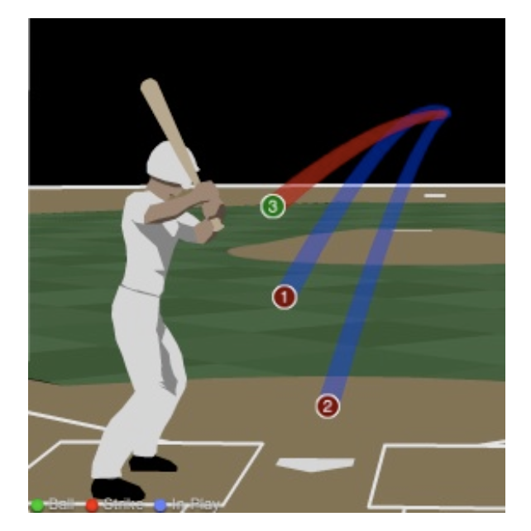
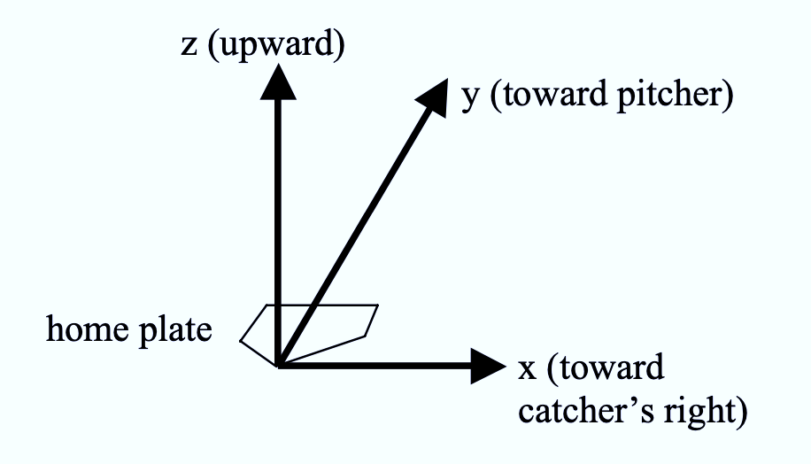
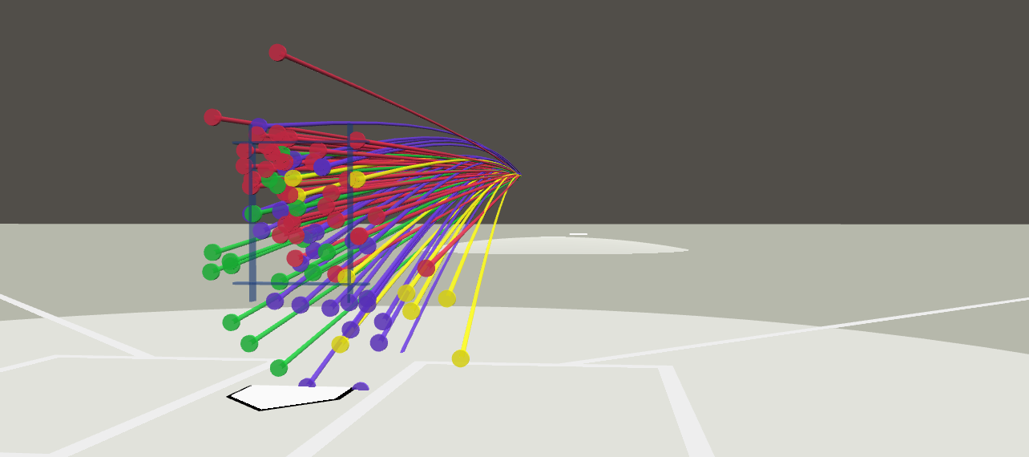
Need for Speed
Dataset contains pitch-level data for every pitch thrown in the 2015-18 MLB seasons
Predictive power of PitchFx data and situational information (game score, runners on base, etc.)

Slide 2
r-squared

Slide 3
residuals

Slide 4
cross validation curve
ridge | lasso | elastic net | random forest
74.43 | 33.5 | 35.96 | 399.5

Slide 5
methods | 90 percent intervals (100 models) | time (single model)
random forest | 0.942 0.989 | 9.17
ridge | 0.988 0.993 | 0.69
elastic net | 0.9988 0.9991 | 0.53
lasso | 0.99912 0.99915 | 0.52

Slide 6
coefficients and importance

Slide 7
Conclusion
random forest doesn’t performs expected
lack of variation in response variable

